Slide 1


Indoor Air
Quality Monitor
BLOOM- AIR

Slide 2



Problem
Indoor Activities
8O% - 90%

Slide 3
Indoor air can be
2 to 5 times more polluted than
Outside your house

Slide 4
Silent Killer in Your House
Approximately 3.8 million people die every year by the Indoor air pollution.

Slide 5




Think of the place that you and your love one spend the most time in

Slide 6
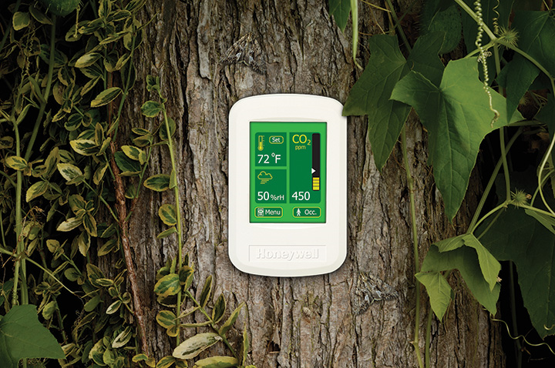
Solution
Bloom Air

Slide 7
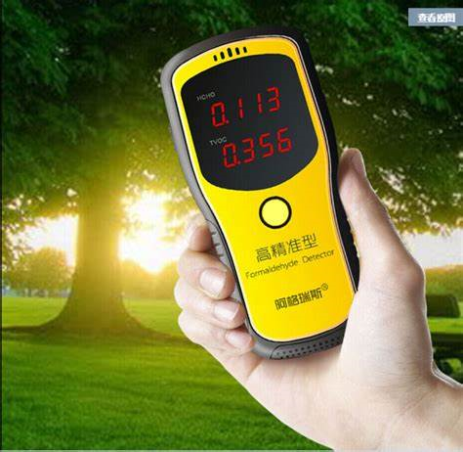
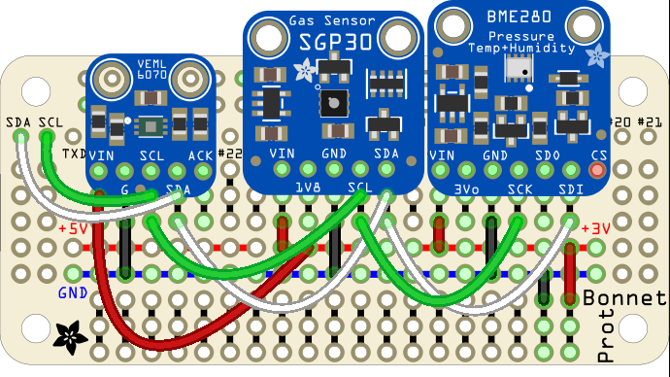
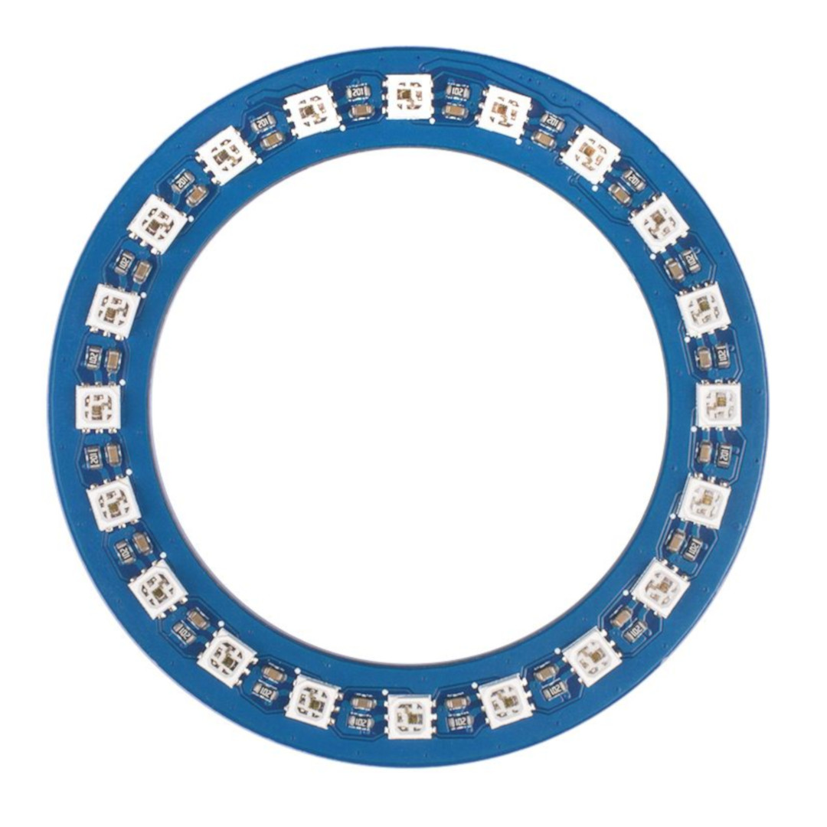
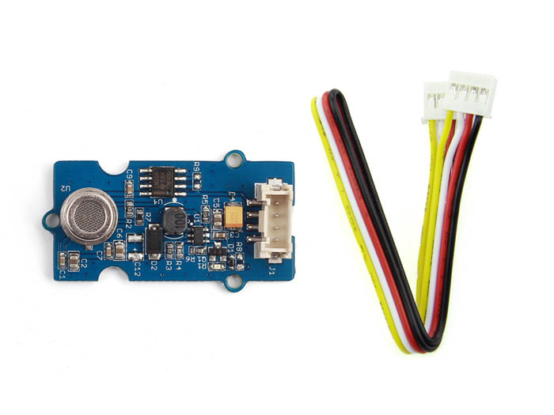
Value Proposition
Grove VOC and Co₂ Gas Sensor
Grove RGB LED Ring (20 WS2813 Mini)
Grove Air Quality Sensor

Slide 8






Customer Segments

Slide 9





Channels

Slide 10





Customer Relationships

Slide 11
Key partners
Ministry Education Youth and Sport
Ministry of Environment
Ministry of Health

Slide 12
4.Advertising
1. Purchas goods from suppliers
Key Activities
3. Design Marketing
- Online
2. Design Prototype

Slide 13
Computer
Budgets
Key Resource
Call center
Marketing
agency
Expertise

Slide 14



Direct online Selling
Retail Selling

Slide 15
Cost Structure
Cost of good sold
Air Quality Sensor4$
Dust Sensor 7$
Wood
1.5$
Grove RGB LED Ring 7$
Vase 3.5$
VOC and Co₂ Gas Sensor 3.5$
Electronic 15$
Box 0.8$
Total = 42.3 $

Slide 16
Financial Projection

Slide 17
Strategy Plan
Year 1 Introduce Product to partners
Year 2 Finding business investors
Year 3 Expand Marketing
Year 4 Research and Development New product
Year 5 Expand to Asian country Marketing

Slide 18
Referent
1. World Health Organization. ( 2018). Household air pollution and health. Search from :
www.who.int/news-room/fact-sheets/detail/household-air-pollution-and-health.
2. World Health Organization. (2018). Ambient(outdoor) air quality and health. Search
from : https://www.who.int/news-room/fact-sheets/detail/ambient-(outdoor)-air- quality-and-health.
3. Alexandra Lill and Sarah Gräber. (2006). Human-Environmental Interactions. Search
from : www.uni-kiel.de/ecologly/users/fmueller/salzau2006/studentpages/Human_
Environmental_Interactions/index.html.

